Slide 1
Lecture 6: tables, text annotations, mathematical expressions, legends, custom axes
Trevor A. Branch
tbranch@uw.edu
Beautiful graphics in R, FISH507H
SAFS, University of Washington

Slide 2
Reminder
Project drafts due in class 21 November for all figures.

Slide 3
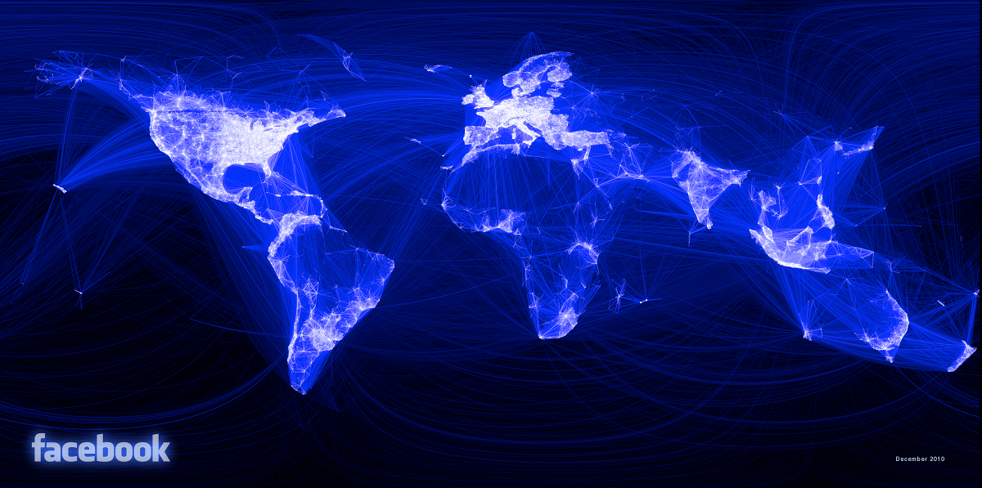
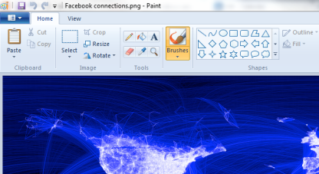

Creator, Paul Butler: “When I tell people I used R, the reaction I get is roughly
what I would expect if I told them I made it with Microsoft Paint and a bottle of Jägermeister.” Plotted from most to least connected cities in order (overplotting), and used colorRampPalette(c("black","blue","white")) to plot more connected cities in whiter color. Transparent colors did not work: too many lines and minimum transparency not enough. Random sample of 10 million pairs of friends.
http://paulbutler.org/archives/visualizing-facebook-friends/

Slide 4
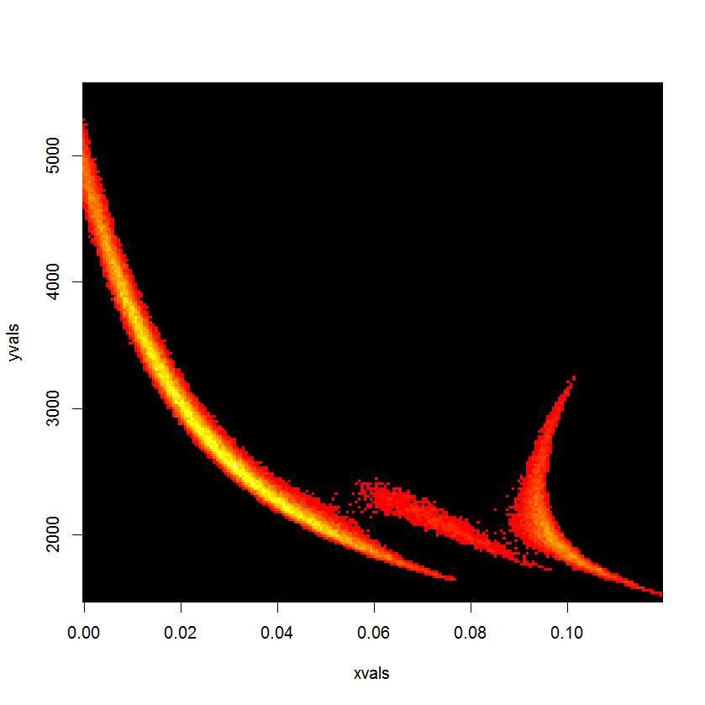
Freaky Halloween posterior
Carrying capacity
Rate of increase
library(gplot)
hist2d(xvec,yvec)
Plot by Cole Monnahan

Slide 5
Tables vs. figures
Day (1998) “How to write and publish a scientific paper” Oryx Press, Phoenix, AZ.
Tufte (1990) “Envisioning information” Cheshire, CT: Graphics Press
Tufte (2006) “Beautiful evidence” Cheshire, CT: Graphics Press
Gelman, Andrew (2011). Why tables are really much better than graphs. Journal of Computational and Graphical Statistics 20:3-7 [plus responses by William Briggs, Michael Friendly, Ernest Kwan, Howard Wainer, Graham Wills; and a rejoinder]
Few (2004) “Show me the numbers” Analytics Press, Oakland, CA

Slide 6
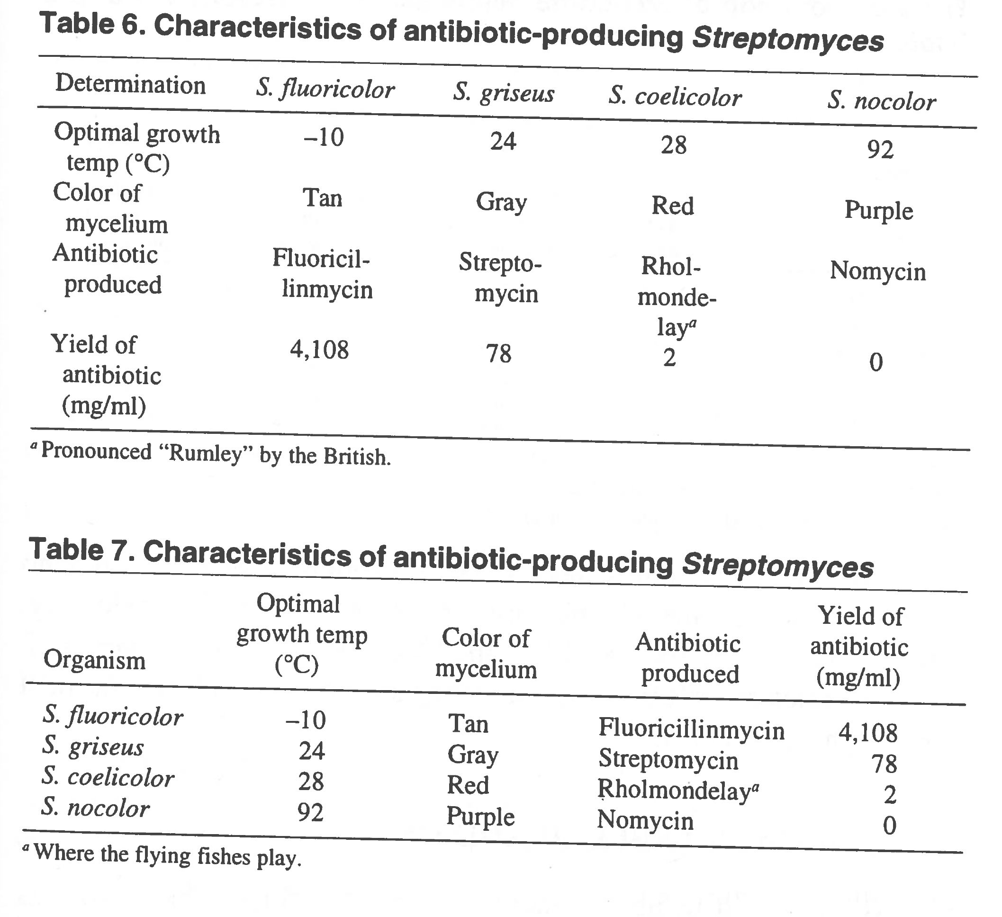
Day (2006) How to write and publish a scientific paper, p. 65

Slide 7
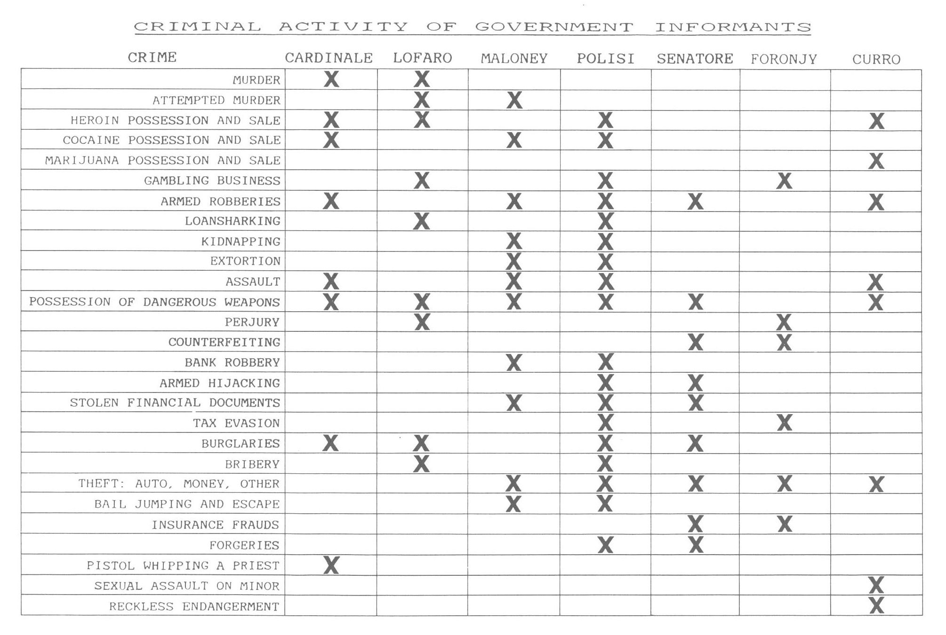
Courtroom chart by reputed mobster John Gotti's lawyers, listing Government witnesses’ criminal activities.
Tufte (1990) Envisioning information, p. 31

Slide 8
Train timetables: 1396 numbers and periods
Tufte (1990) Envisioning information, p. 46-47

Slide 9
Train timetables: 619 characters (777 fewer)
Keihin Express Line, Yokohama Station,
Sagami Tetsudo Company, 1985 timetable, p. 76
Tufte (1990) Envisioning information, p. 46-47

Slide 10
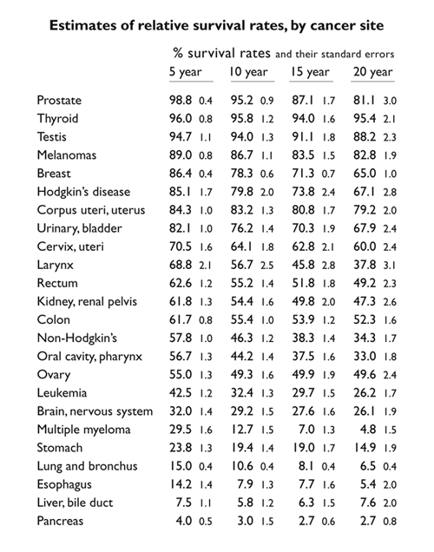
Brenner (2002)
Tufte redesign
Brenner (2002) The Lancet 360:1131-1135
Tufte (2006) Beautiful evidence, p. 174
Notes:
This is currently the No. 3 search item returned on Google under “cancer survival rates”.

Slide 11
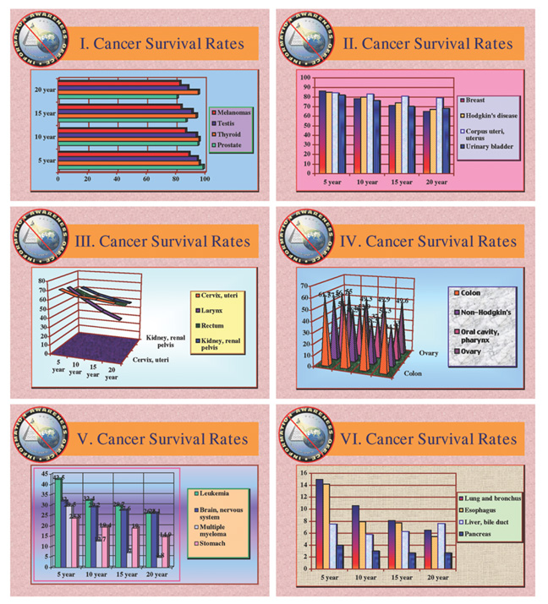
Tufte (2006) Beautiful evidence, p. 175
Notes:
It is quite possible to turn this into a series of disastrous plots.

Slide 12
Gelman (2011)
“Graphs are gimmicks, substituting fancy displays for careful analysis and rigorous reasoning. It is basically a trade-off: the snazzier your display, the more you can get away with a crappy underlying analysis. Conversely, a good analysis does not need a fancy graph to sell itself. The best quantitative research has an underlying clarity and a substantive importance whose results are best presented in a sober, serious tabular display. And the best quantitative researchers trust their peers enough to present their estimates and standard errors directly, with no tricks, for all to see and evaluate. Let us leave the dot plots, pie charts, moving zip charts, and all the rest to the folks in the marketing department and the art directors of Newsweek and USA Today. As scientists we are doing actual research and we want to see, and present, the hard numbers.”
Gelman (2011) Journal of Computational and Graphical Statistics 20(1): 3-7
Notes:
Originated as an April 1 joke blog in the voice of an older scientist.

Slide 13
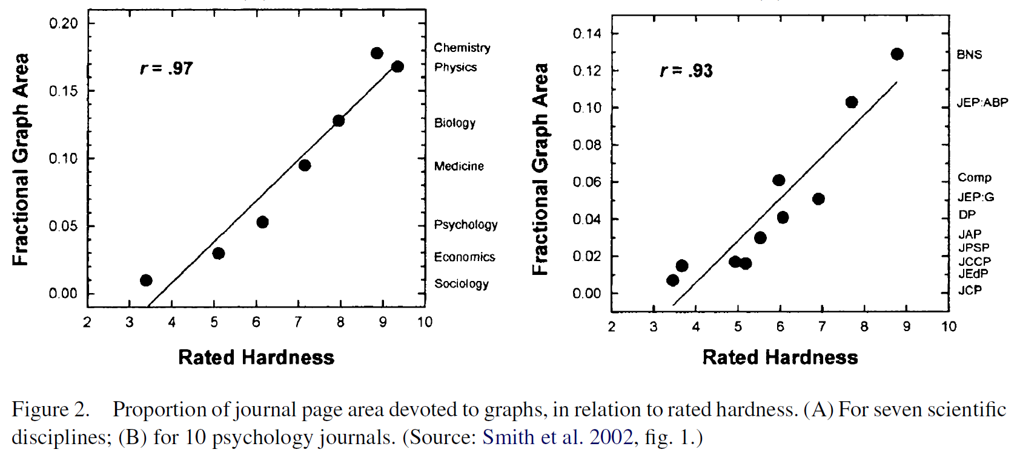
Friendly & Kwan (2011) Journal of Computational and Graphical Statistics 20(1): 18-27

Slide 14
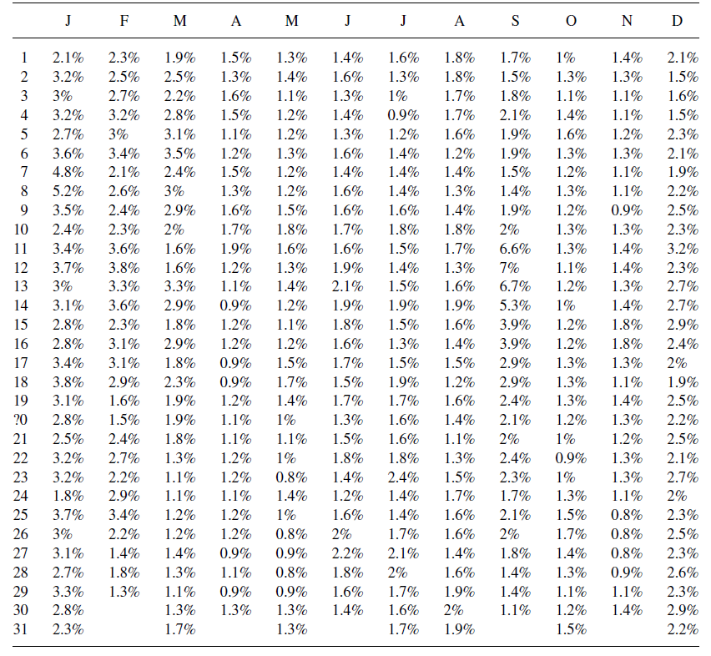
Proportion of flights canceled by day of the year
Wills (2011) Journal of Computational and Graphical Statistics 20:28-35

Slide 15
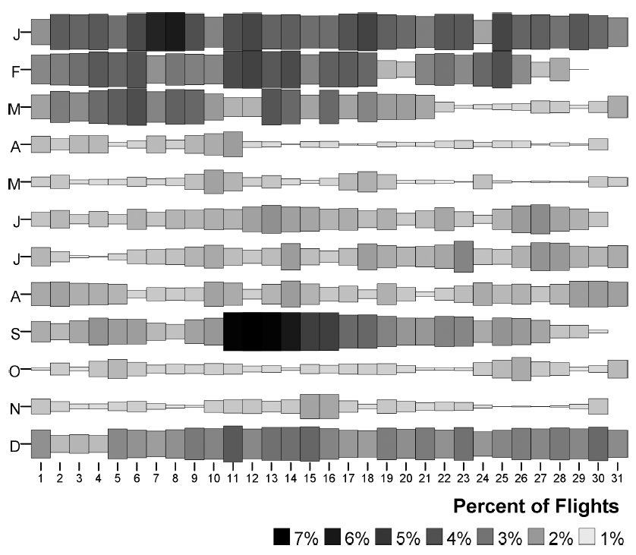
Proportion of flights canceled by day of the year
Wills (2011) Journal of Computational and Graphical Statistics 20:28-35
Notes:
Size proportional to absolute counts of canceled flights, colors proportional to the proportions of flights canceled.

Slide 16
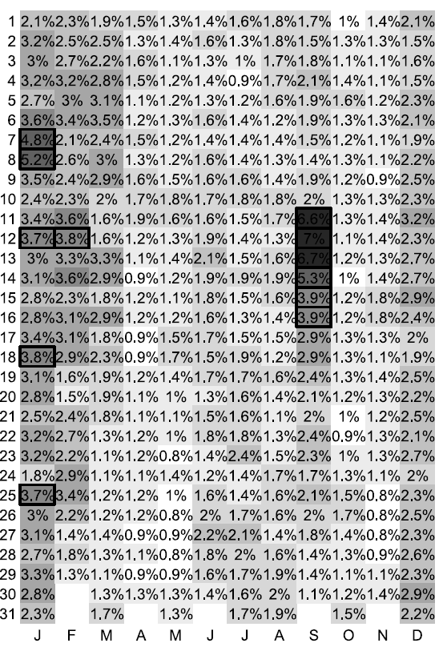
Proportion of flights canceled by day of the year
Wills (2011) Journal of Computational and Graphical Statistics 20:28-35
Notes:
Boxes denote cells that are significantly different from a regression of numbers of flights vs. percent of canceled flights.

Slide 17
Conditional formatting in Excel (under Home ribbon)

Slide 18
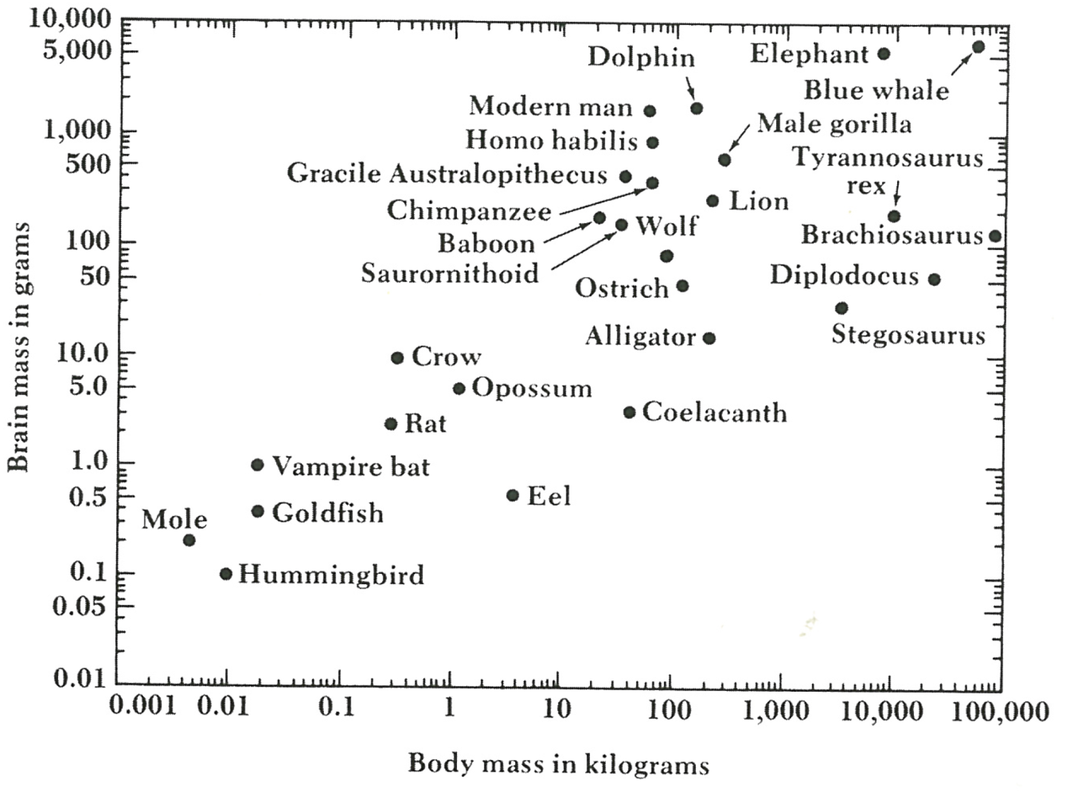
Text annotations
Tufte (2006) Beautiful evidence, p. 118
Original: Sagan (1977) The dragons of Eden

Slide 19
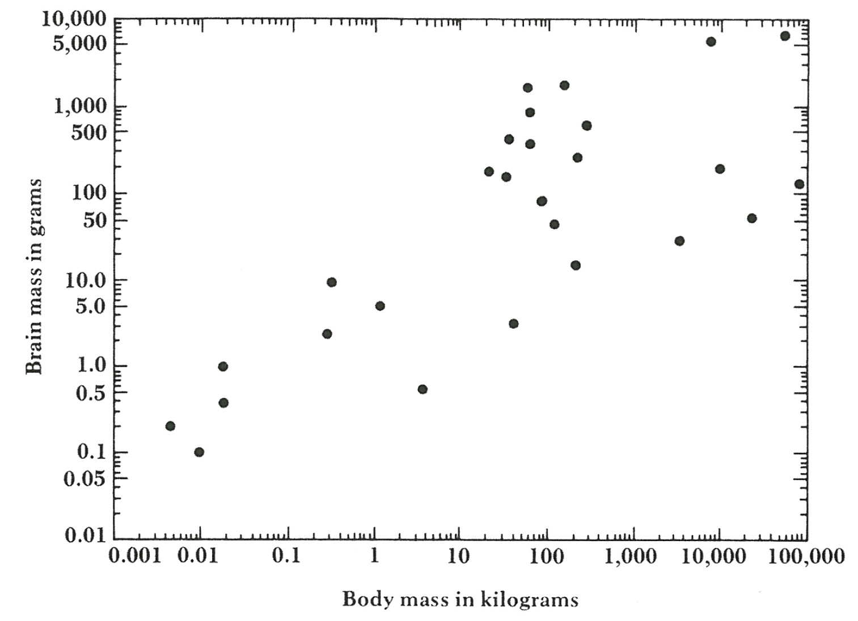
Tufte (2006) Beautiful evidence, p. 119

Slide 20
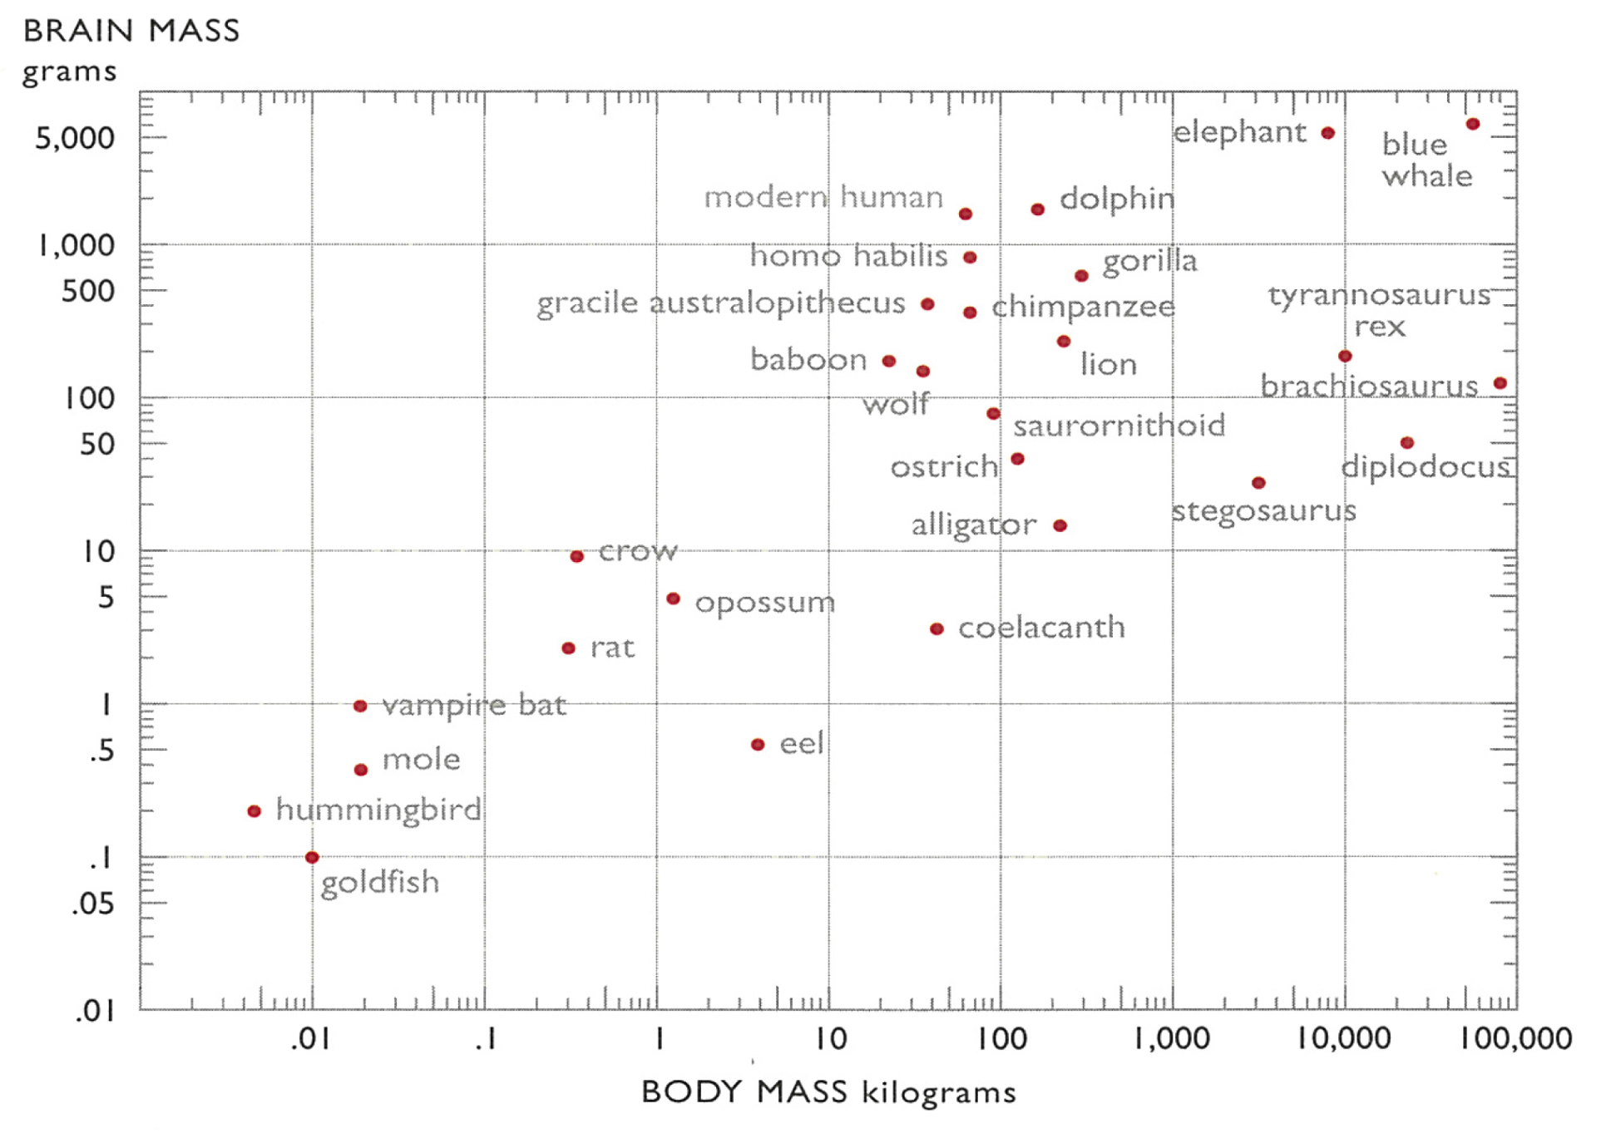
Tufte (2006) Beautiful evidence, p. 120

Slide 21
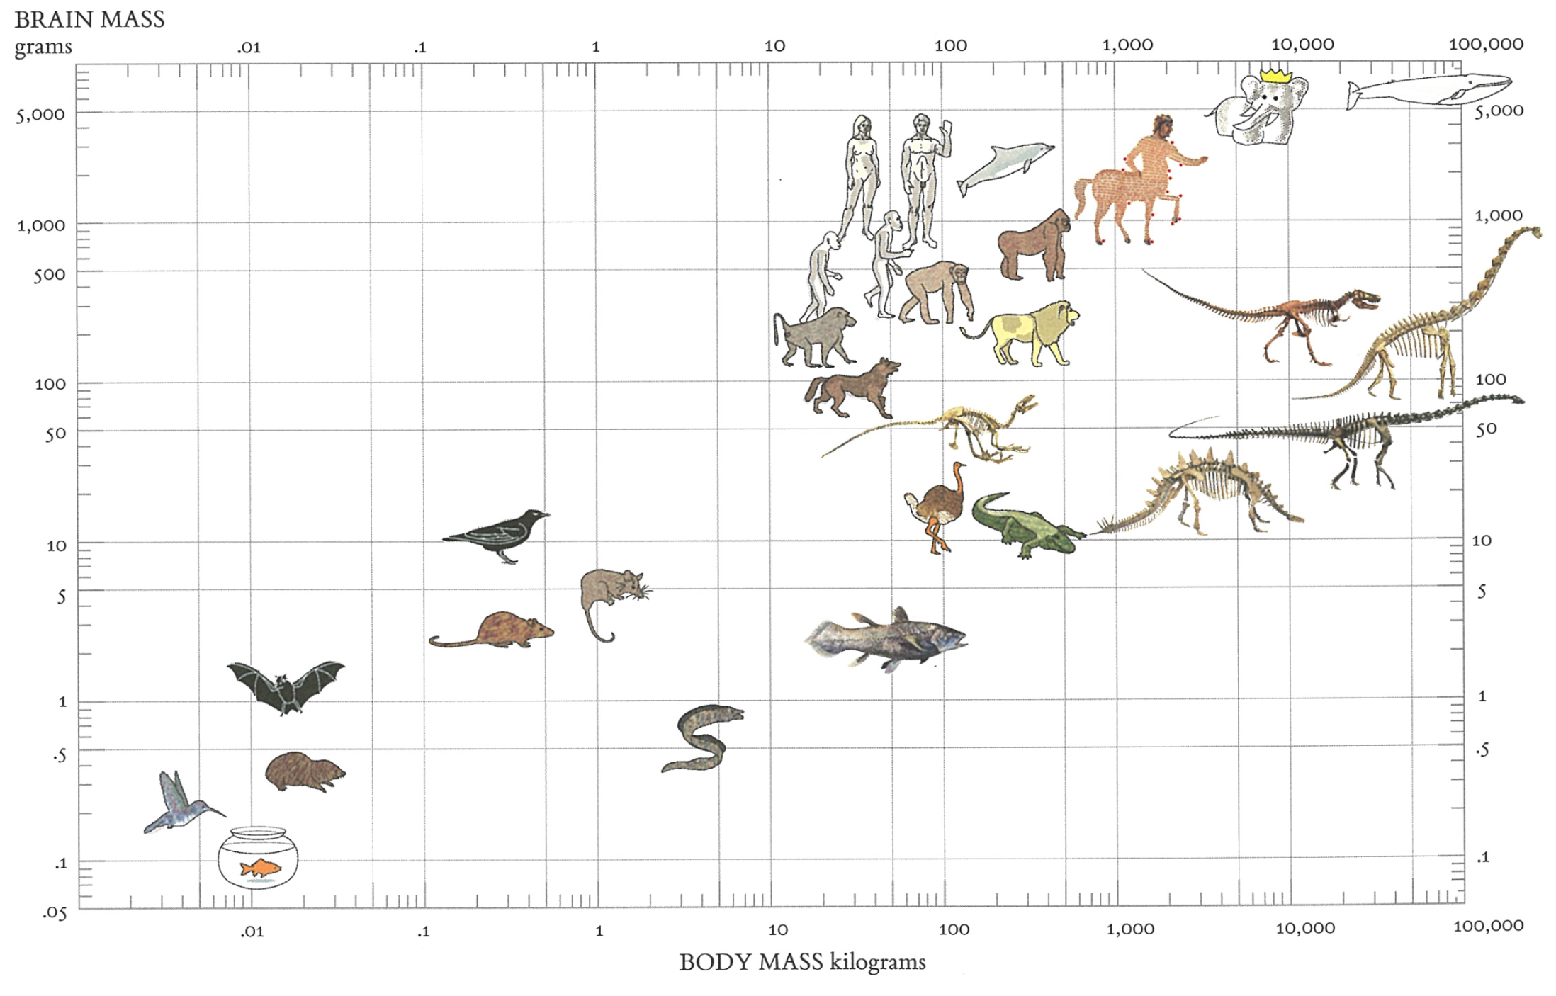
Tufte (2006) Beautiful evidence, p. 120

Slide 22
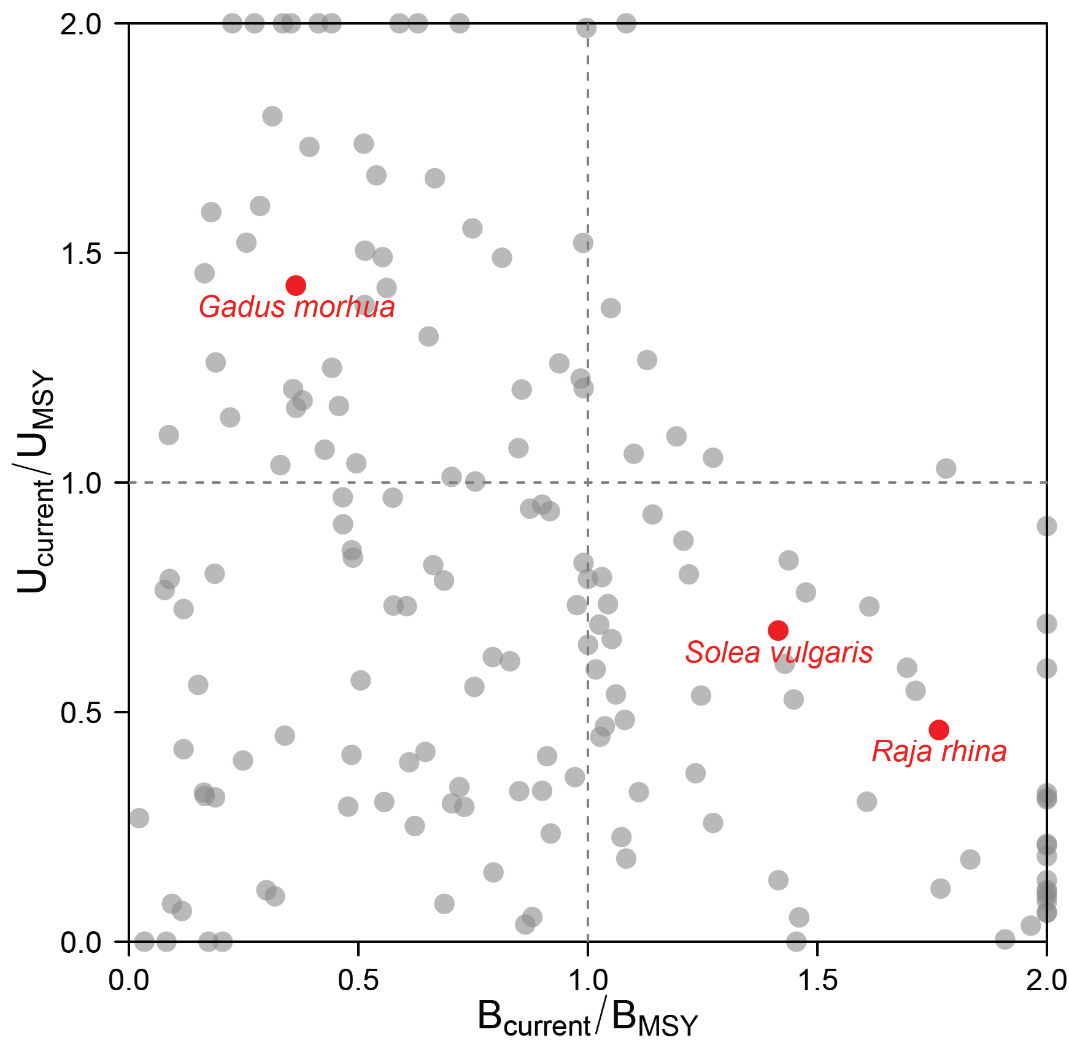
Redrawn from Worm et al. (2009) Science 325:578-585

Slide 23
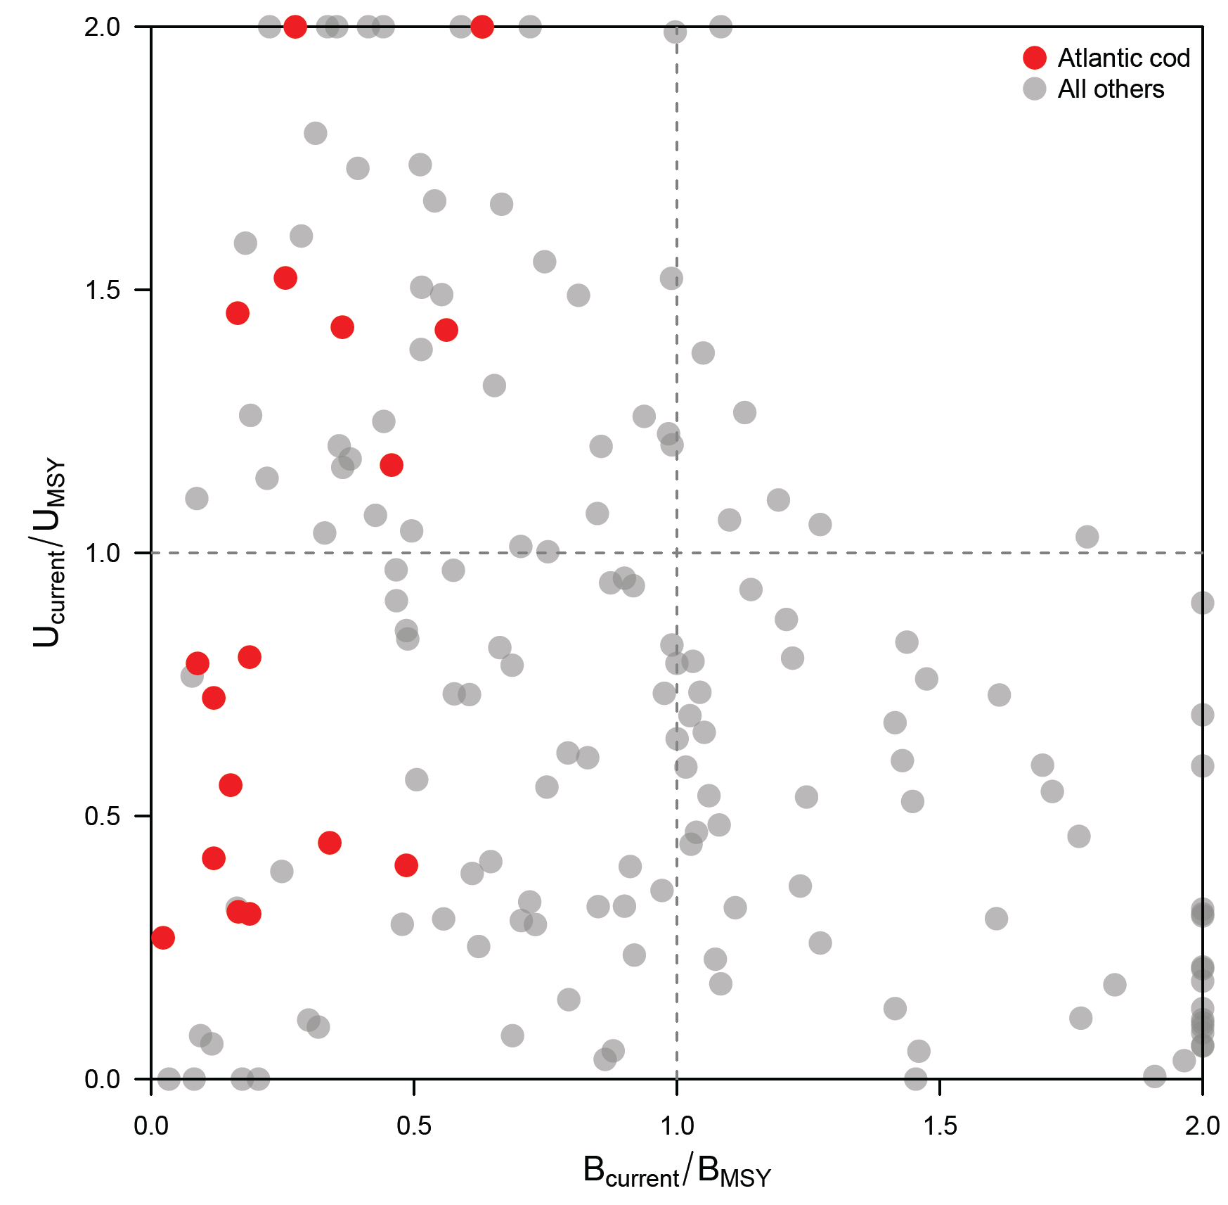
Redrawn from Worm et al. (2009) Science 325:578-585

